Slide 1
Getting Started with JT65 and JT9 on the HF Bands
By John Bartos, AB3LZ

Slide 2
What is JT65?
A form of digital communications originally developed by Joe Taylor, K1JT, for Moon-bounce (EME) applications where signals are extremely weak (VHF/UHF).
Uses sophisticated digital signal processing
Also relies on redundancy – it sends the information over and over

Slide 3
Who is Joe Taylor (K1JT)
Licensed as a teenager (K2IPT).
A math wiz whose interest in radios led to a career in radio astronomy.
Co-discoverer of the first pulsar in a binary system.
Tracked shrinking orbit of this binary system for 30 years.
Orbit was shrinking due to mass transfers.

Slide 4
Who is Joe Taylor (K1JT)
Proved the orbit shrinking and mass loss was due to gravitational radiation.
Predicted by Einstein's Theory of General Relativity to an accuracy of 1%.
First to prove the existence of gravitational radiation.
Awarded the Noble Prize in physics in 1993.
Retired physicist/professor but still an active ham working on weak signal recognition.

Slide 5
65 Different Tones
A 1270.5 Hz synchronizing tone
64 additional tones to carry the information (FSK)
On the air it sounds like someone playing music

Slide 6
Timing is Everything
Each JT65 transmission lasts precisely 46.8 seconds.
During transmission only a small amount of information is sent – about 13 characters
Station clocks must agree within about 1 seconds (Accurate time is important)
As much as 80% of the transmission can be lost and still be decoded

Slide 7
Taking Turns
Stations take turns transmitting
Stations transmit on even or odd UTC minutes, and then listen on the following minutes

Slide 8
Just the Facts!
A JT65 contact is designed to exchange the bare minimum information needed to qualify as a “QSO”
Call signs
Signal Reports
Grid Squares

Slide 9
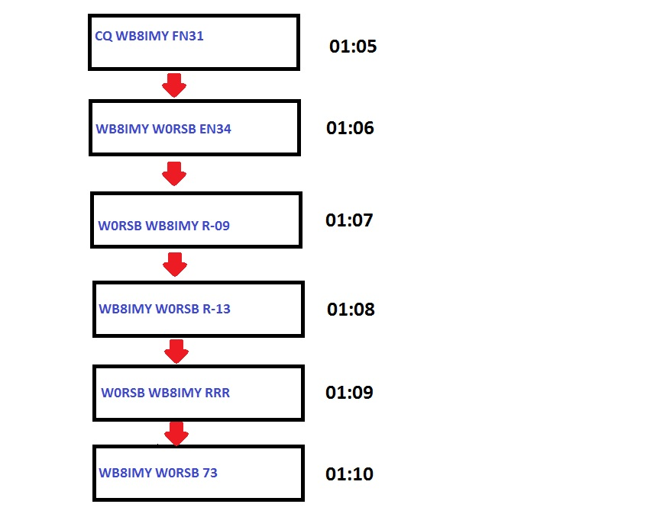
Transmitting and Receiving by Turns – Typical QSO

Slide 10
WSJT (Weak Signal Joe Taylor)
Program written by K1JT to facilitate weak signal VHF/UHF communications.
Supported 4 communication protocols:
FSK441: for meteor scatter
JT6M: for ionospheric scatter
JT-65: for EME at VHF/UHF and for HF skywave propagation
JT4: For EME and tropospheric propagation on microwave bands
Not user friendly.

Slide 11
JT65 on HF
The JT65 “revolution” on the HF bands is primarily due to Joe Large, W6CQZ.
Joe wrote a piece of software called JT65-HF that makes it much easier to operate JT65 and make successful contacts.
JT65-HF is currently available for Windows only.
Excellent mode for low power or antenna restricted stations.

Slide 12
WSJT-X
Joe Taylor wrote user friendly software adapting the original VHF/UHF program (WSJT) to HF operation.
Joe has also developed WSJT-X which decodes both JT-65 and JT-9.
Programs available for Windows and MAC OS.
Source code is available to compile on LINUX operating systems.

Slide 13
JT9 on HF, MF and LF
JT9 is a new weak signal protocol for HF, MF and LF use.
Functionally similar to JT65
Differences:
9 tones in lieu of 65.
BW of 15.6 HZ in lieu of ~185 HZ.
JT65 decoder clamped at -1dB and JT9 decoder good to +49dB. (JT9 decoder linear over a large range)
JT65 S/N threshold is -25dB vs. the JT9 threshold @ -27dB.
Software operation identical for both modes.

Slide 14
Contacts by the “Colors”
WSJT-X uses color highlighting to indicate which stations are calling CQ, which stations are in contact with each other, and which stations are transmitting to you.
The program also has preformatted responses that you can send by simply double clicking on the appropriate line.

Slide 15
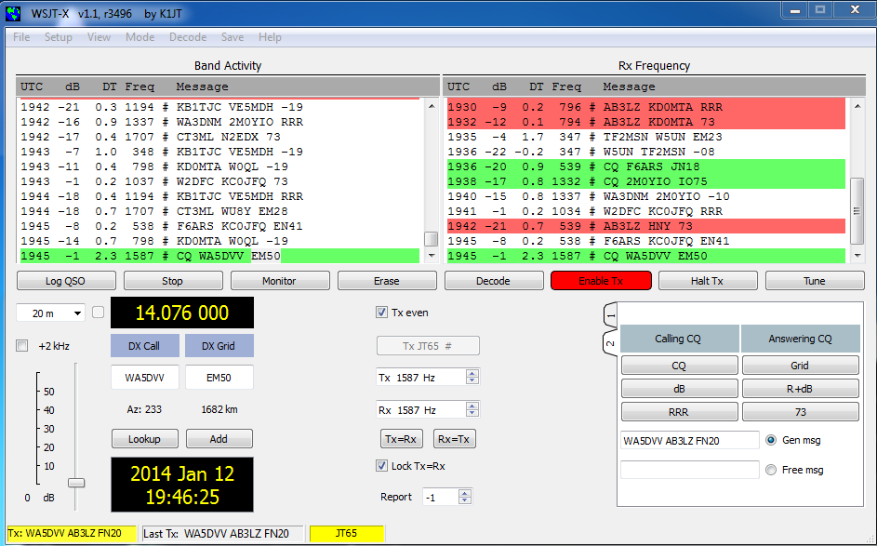
WSJT-X Control Panel

Slide 16
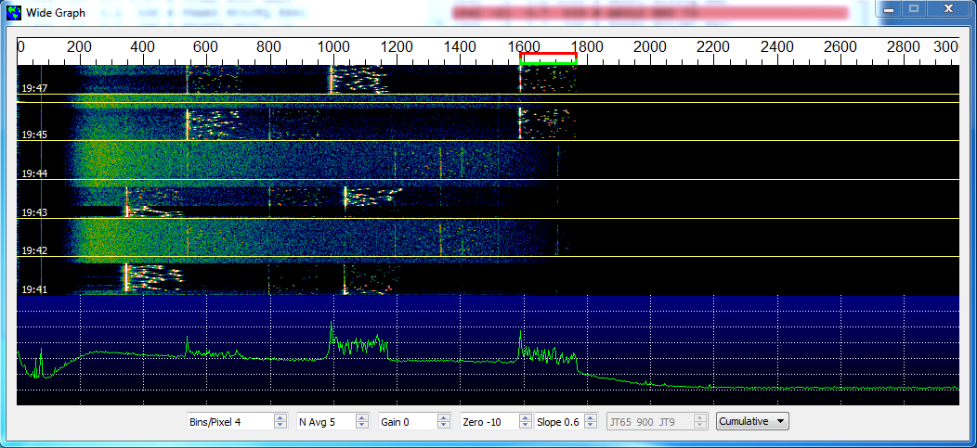
WSJT-X Water Fall Plots
JT-65 Water Fall & FFT

Slide 17
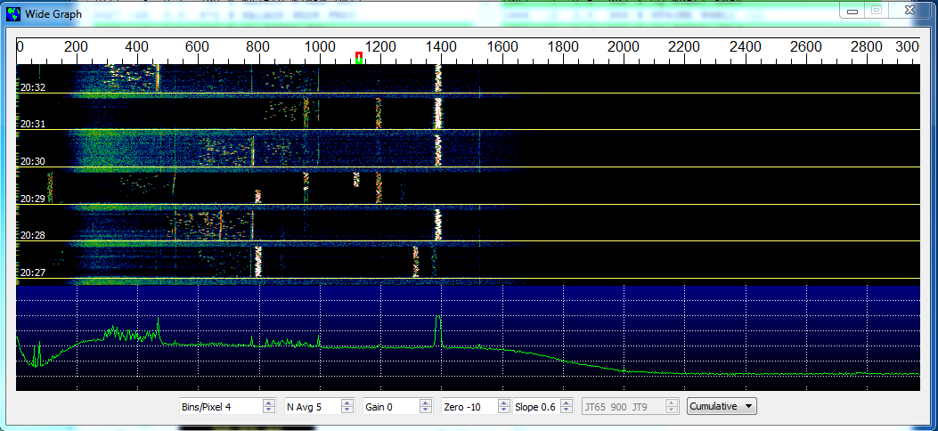
WSJT-X Water Fall Plots
JT-9 Water Fall & FFT

Slide 18
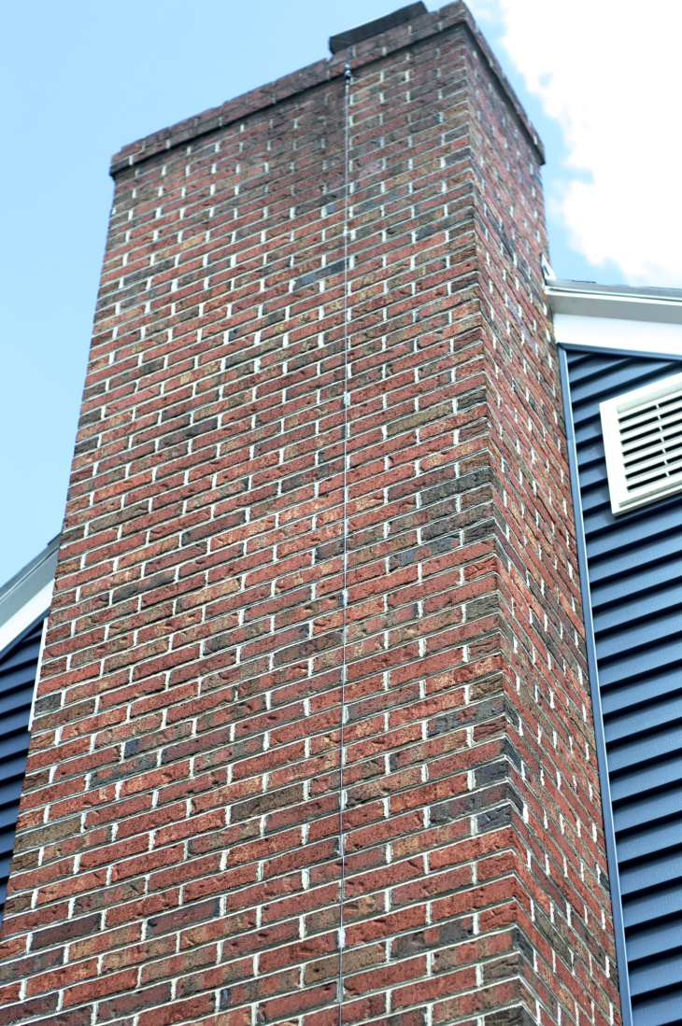
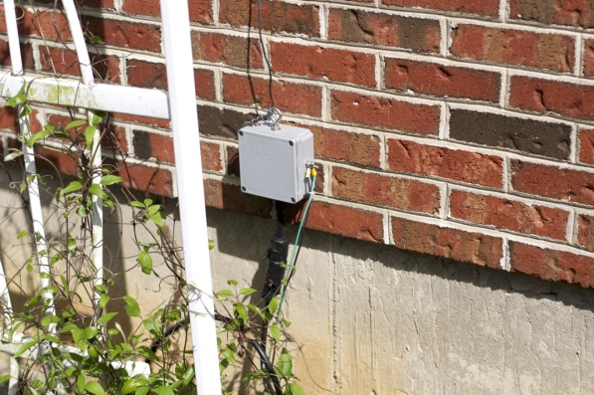
Let’s Follow an Actual Contact, Step by Step
I made this contact while running just 15W on 20 meters using 24 ft. vertical wire running up my chimney.

Slide 19
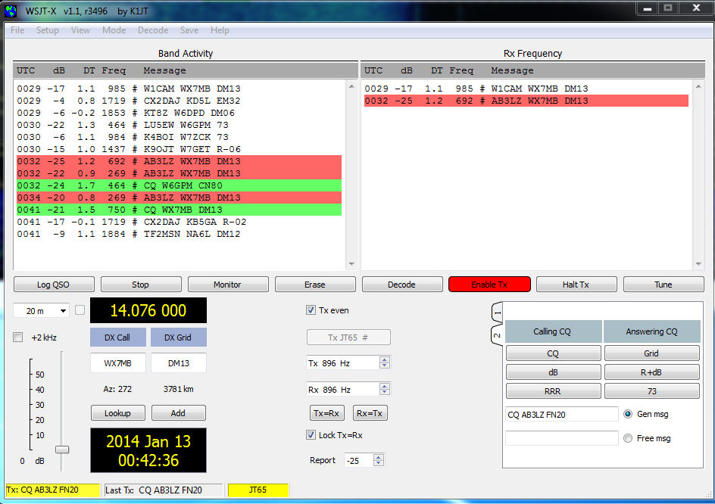
I’m Calling CQ…

Slide 20
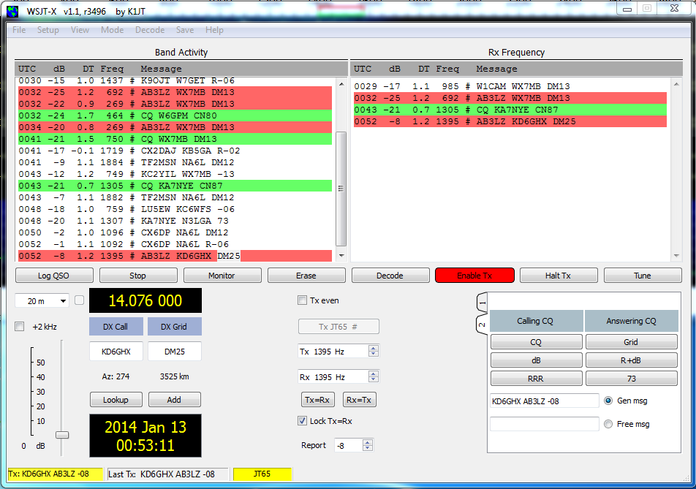
KD6GHX Has Answered. I’m Replying with a Signal Report

Slide 21
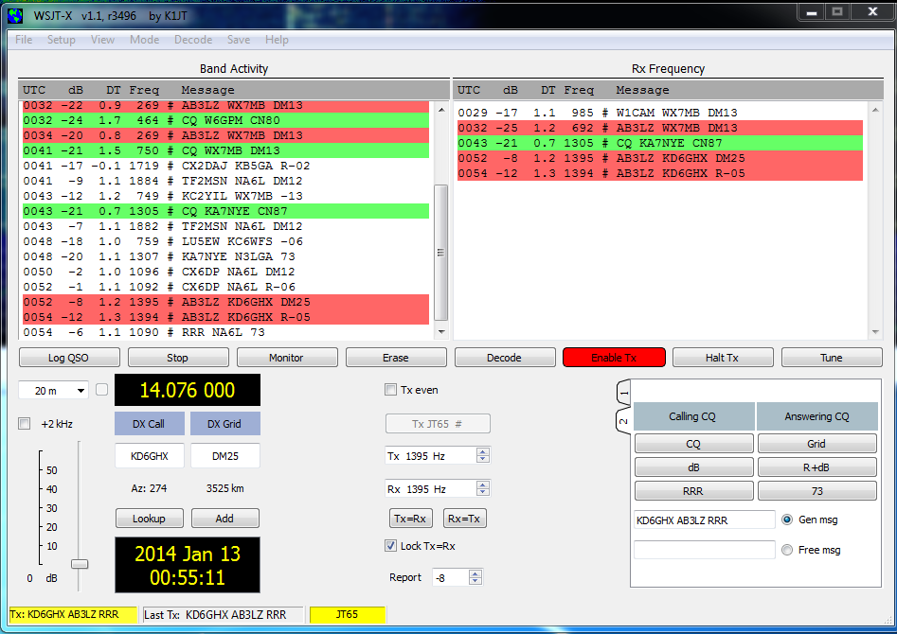
KD6GHX Confirms My Report and Gives Me a Report of -05 dB. I Reply “RRR”

Slide 22
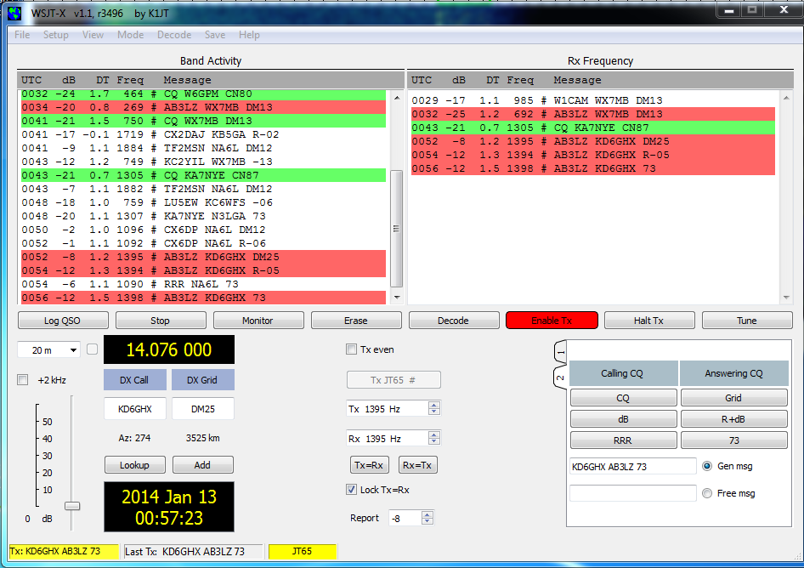
KD6GHX Sends 73 and I do the Same

Slide 23
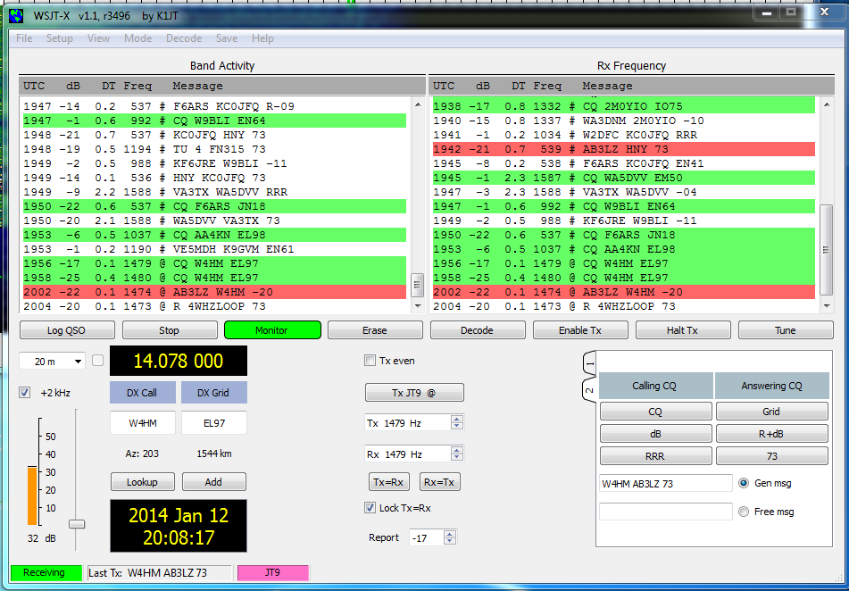
You Can Also Send Short Text Messages. The White Text is W4HM Telling Me that he is Running 4W to a Loop Antenna

Slide 24
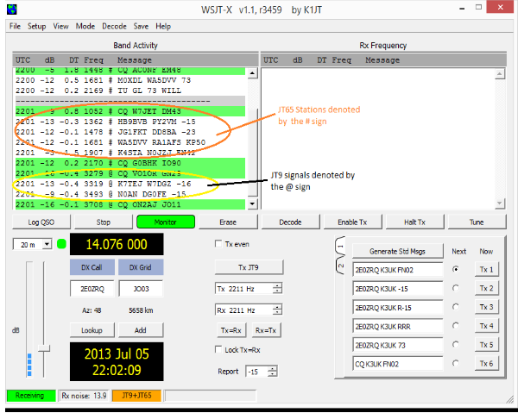
WSJT-X is Bilingual

Slide 25
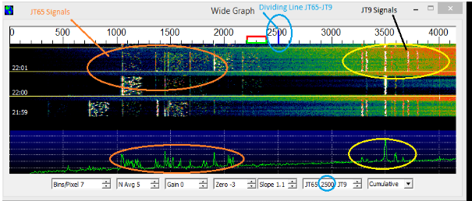
WSJT-X is Bilingual

Slide 26
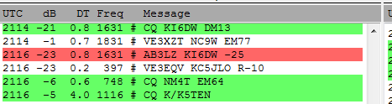
Understanding the WSJT-X Decoding Screen
UTC – When the signal was received.
dB - The strength (S/N) of the received signal in dB. Higher is better. -1 is the upper limit.
DT – The calculated offset of the received signal from your local clock. Values of .3 to 1.9 are typical.
Freq – Offset in Hz from the center point (0).
# @ – # is a JT65 decode and @ is a JT9 decode.
Message – Information exchange.

Slide 27
JT65 & JT9 Contacts Are Valid For Most Awards
DXCC
Worked All States
Worked All Continents
eQSL Awards
Also supported by ARRL’s Logbook of The World

Slide 28
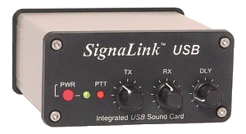
What Do You Need to Try JT65 on HF?
SSB Transceiver
Computer with sound device
Interface

Slide 29
Download and Install the Free JT65 Software
WSJT-x
http://www.physics.princeton.edu/pulsar/K1JT/wsjt.html
http://www.physics.princeton.edu/pulsar/K1JT/WSJT-X_Users_Guide_v1.1.pdf
http://obriensweb.com/wsjtx.html (The Old Codger’s Guide to JT65 and JT9 via WSJT-X Software)
JT65-HF
http://jt65-hf/downloads/
Clock Programs (Time is Important)
http://www.satsignal.eu/ntp/setup.html (Meinberg NTP)
http://www.thinkman.com/dimension4/

Slide 30
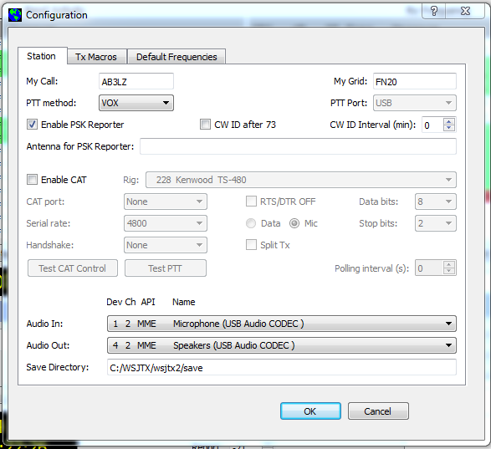
Configure the Software First

Slide 31
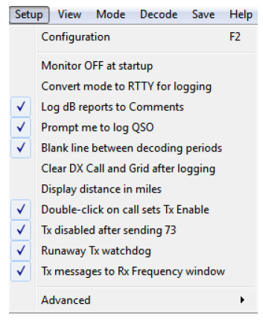
Configure the Software First

Slide 32
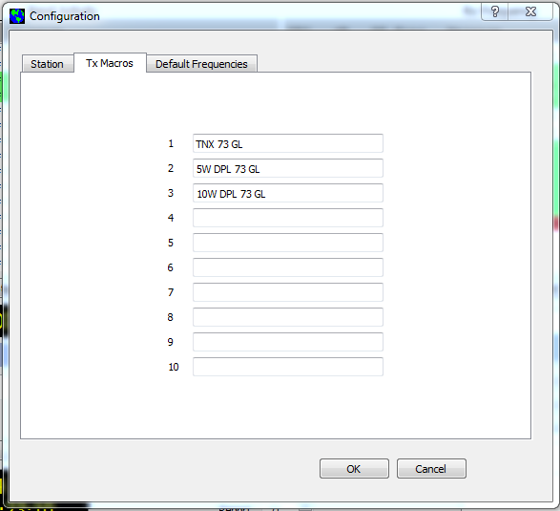
Define Tx Macros

Slide 33
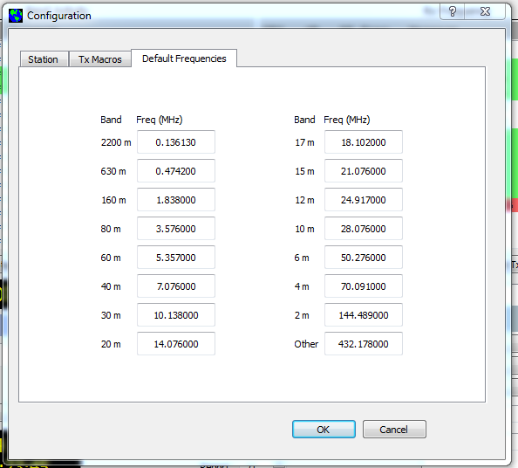
Define Default Frequecies

Slide 34
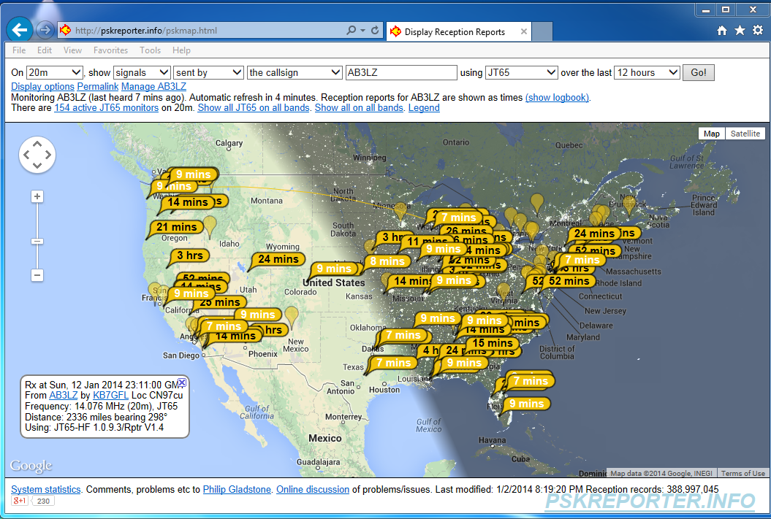
If you have an Internet Connection, You can Participate in the Reporting Network
http://pskreporter.info/pskmap.html

Slide 35
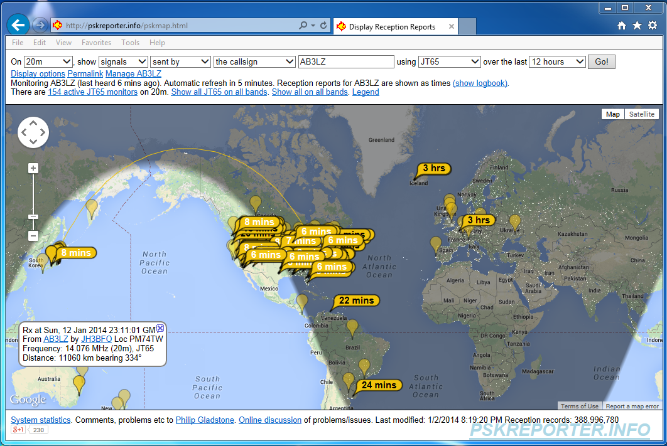
I Monitored Reception of my JT65 15W Signal on PSKReporter

Slide 36
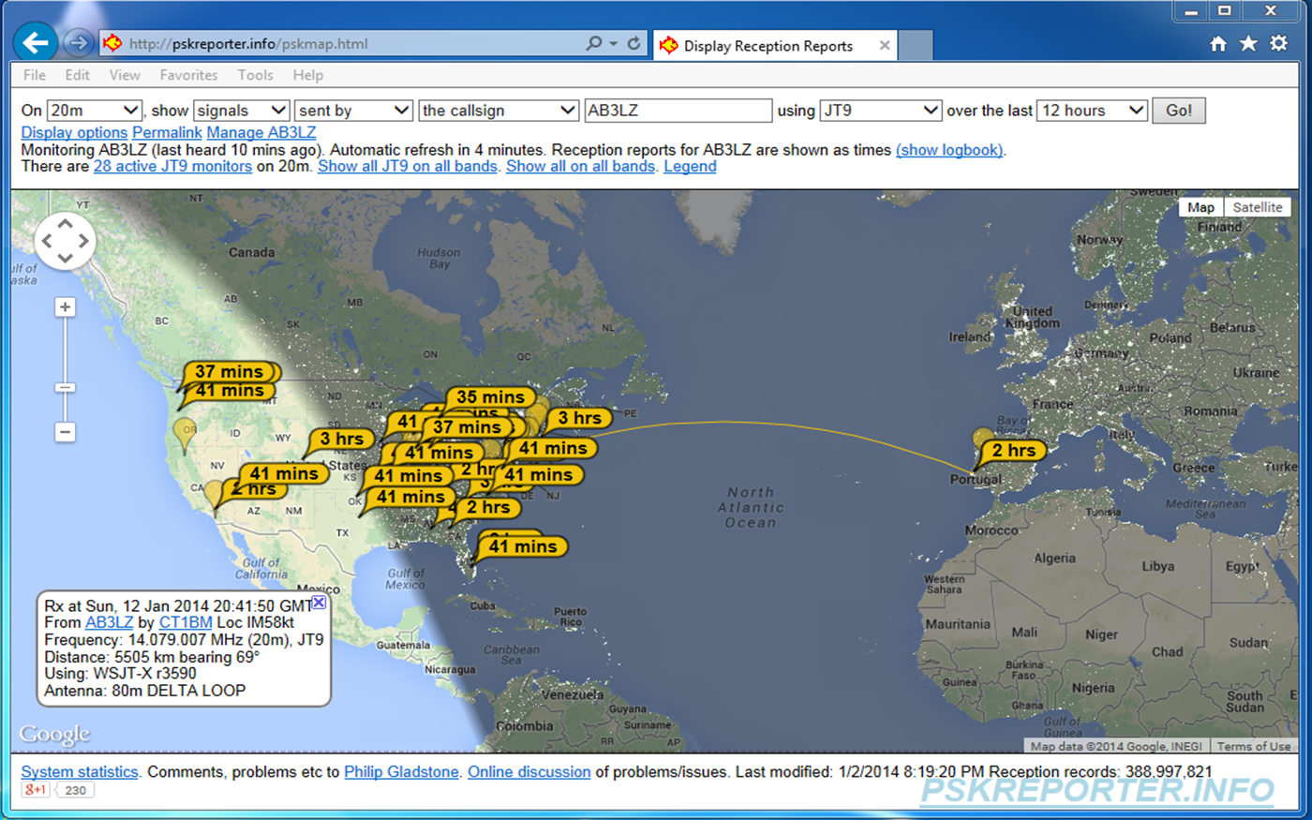
I Monitored Reception of my JT9 15W Signal on PSKReporter

Slide 37
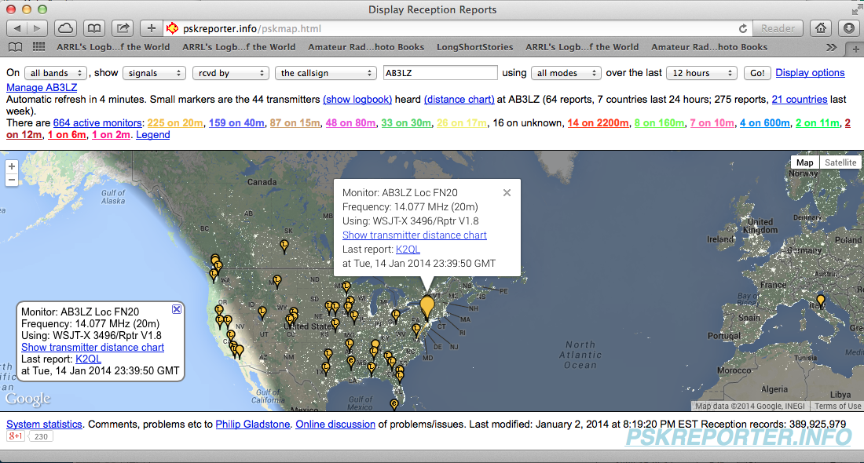
Stations I Monitored and Reported to pskreporter

Slide 38
db Refresher
% Power = 100% X anti log (db/10)
% Voltage = 100% X anti log (db/20)
S/N Ratio with respect to power received:
0 db = 100% (signal power =100% of noise power)
-5 db = 31.6% (signal power =31.6% of noise power)
-10 db = 10% (signal power =10% of noise power)
-15 db = 3.1% (signal power =3.1% of noise power)
- 20 db = 1.0% (signal power =1.0% of noise power)
-25 db = 0.32% (signal power =0.32% of noise power)
-27 db = 0.2% (signal power =0.2% of noise power)

Slide 39
See You on JT65 and JT9!
Questions and Comments

